Slide 1

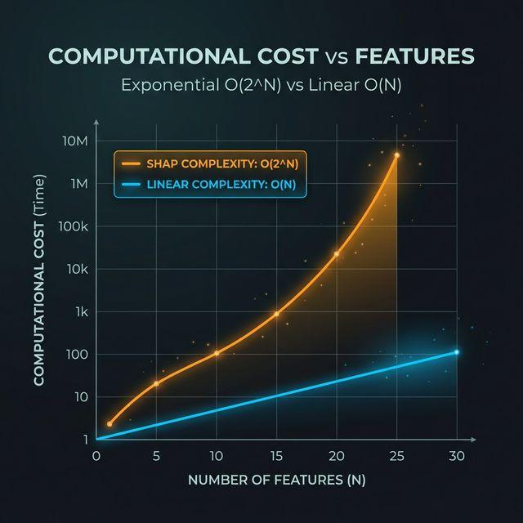

The Explainability Bottleneck
Opaque DNNs
Deep Neural Networks are powerful "black boxes," making their internal logic inaccessible.
SHAP COMPLEXITY: FEATURES VS. COST
Computational Cost
SHAP provides faithful attribution but is impractically slow for real-time applications.
High-Stakes Demand
Real-time explanations are critical for healthcare, finance, and regulatory compliance.
PROBLEM

Slide 2
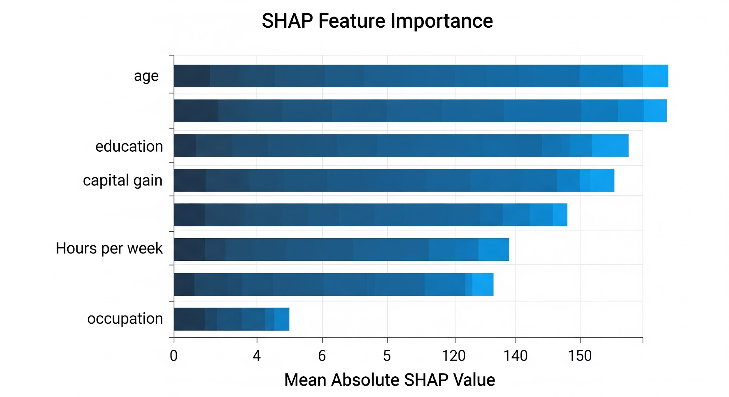
SHAP: Fairness Through Game Theory
!
Mathematical Origins
SHAP (Shapley Additive Explanations) is rooted in cooperative Game Theory, specifically the work of Lloyd Shapley.
VISUAL EVIDENCE: FEATURE IMPORTANCE
✓
The "Fair" Allocation
It provides a mathematically fair credit allocation for each individual input's contribution to a prediction.
Figure 1: Attribution of model prediction back to inputs

Slide 3
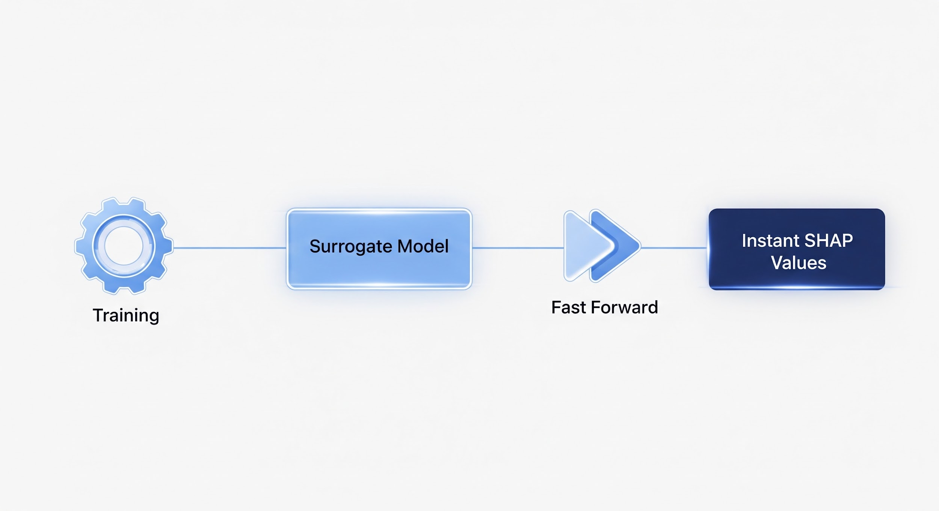
The InstaSHAP Workaround
Training-Time Shift
Moves heavy computation from inference to training time.
CONCEPTUAL FLOW: INSTANT EXPLANATIONS
Surrogate Modeling
Trains an additive model specifically to match SHAP values.
Zero Overhead
Achieves zero inference-time overhead for explanations.

Slide 4
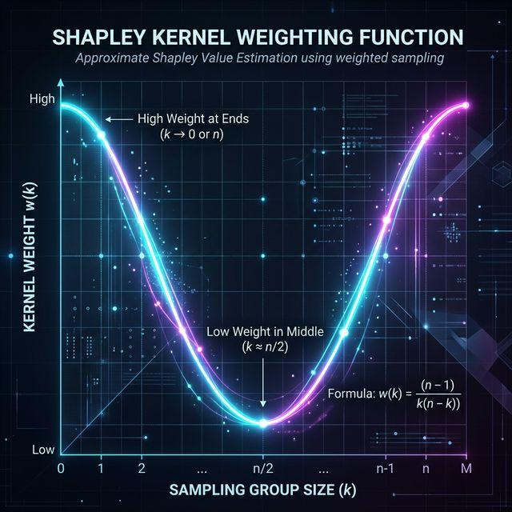
The Shapley Kernel: Mathematical Optimality
1
Optimal SHAP Recovery
Weighting the training loss with the Shapley Kernel ensures mathematically optimal SHAP value recovery.
VISUAL PROOF: WEIGHTING FUNCTION
2
Weighting Distribution
High importance is placed on masking all or no features, with lower weights in the middle of the distribution.

Slide 5

Full Pipeline Details
1
Black-Box Training
Train the initial model on raw data to establish the target behavior.
PIPELINE ARCHITECTURE VISUALIZATION
2
Masked Surrogate
Create a surrogate to approximate behavior under feature hiding.
3
InstaSHAP Alignment
Train InstaSHAP against the surrogate's specific outputs.

Slide 6



Multiclass Benchmark Results
PERFORMANCE METRICS
ACCURACY DISTRIBUTION: COVERTYPE
Adult Income
84.00%
Best Black-box Accuracy
Covertype
69.13%
Best GAM-2 Accuracy
Blackbox
gam-1
gam-2
InstaSHAP

Slide 7


Base Model Architecture
Multi-Layer Perceptron (MLP)
Training Objectives
APPLICATION SCOPE
LOSS FUNCTIONS
Serves as the foundational architecture for both Black-box and Surrogate modeling phases.
Standard Cross-Entropy
Primary for classification tasks.
NETWORK DIMENSIONS
Mean Squared Error (MSE)
Primary for regression tasks.
256
128
Two hidden layers with specified node counts.

Slide 8


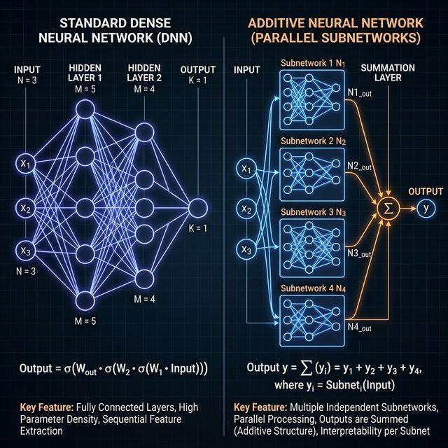

The Additive Network Trick
COMPONENT ARCHITECTURE
Independent MLPs
InstaSHAP uses dedicated ComponentMLPs [96, 64] for every single feature.
STRUCTURAL GUARANTEE
Additive by Design
Outputs are directly summed, ensuring strict additivity and inherent interpretability.

Slide 9
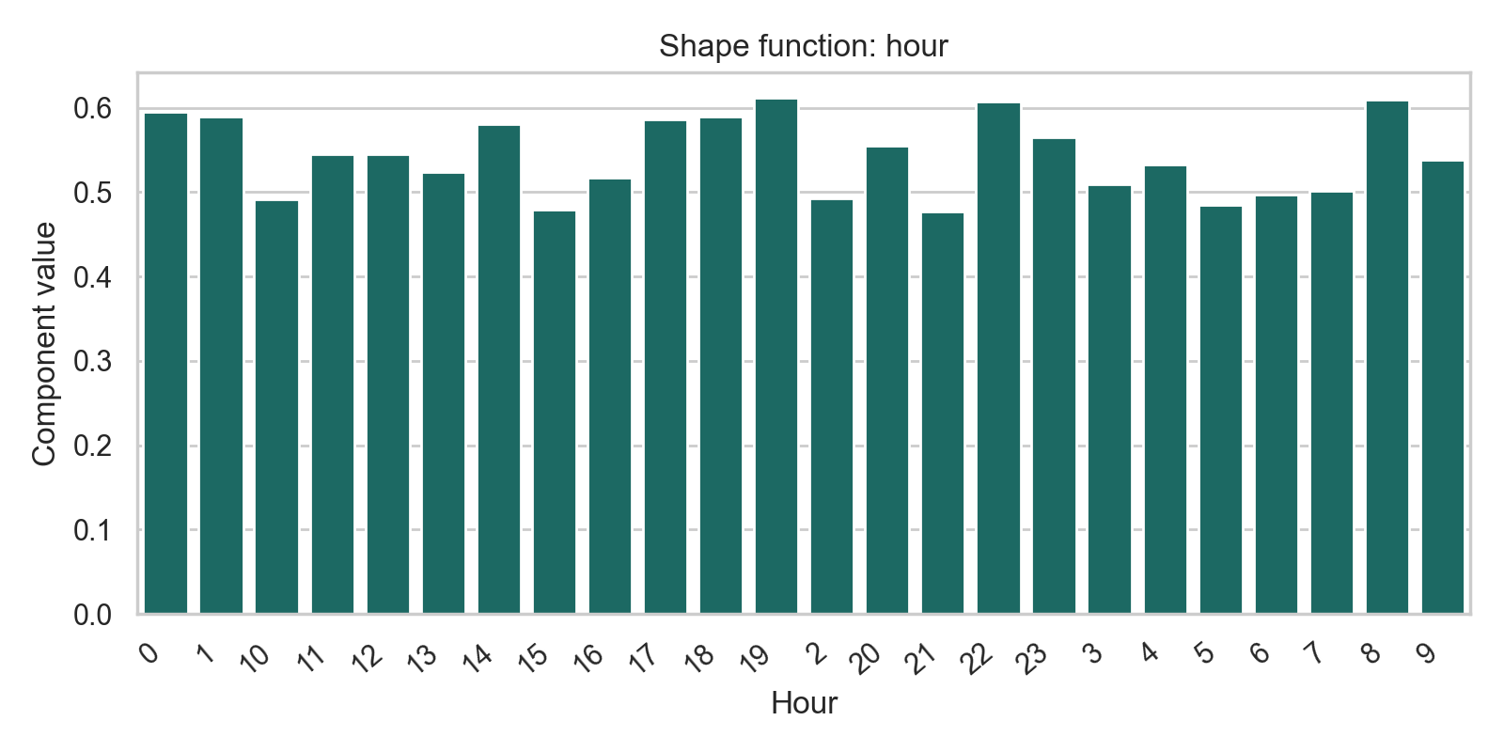
Bike Sharing Dataset: Key Results
Black-Box Model
GAM-2 (Winner)
InstaSHAP
204.85
187.43
203.98
NMSE% (Baseline)
Outperformed Black-box!
NMSE% (Surrogate)
Standard MLP [256, 128] architecture.
Best performing model on the regression task.
Matches Black-box performance with ~1500x speed.
Feature Analysis: Hour vs. Count
Observations:
The "Hour" feature shows significant interaction peaks during commute times.
GAM-2 captures non-linear effects more efficiently than the standard MLP.
InstaSHAP's additive structure allows for direct plotting of these interactions.

Slide 10
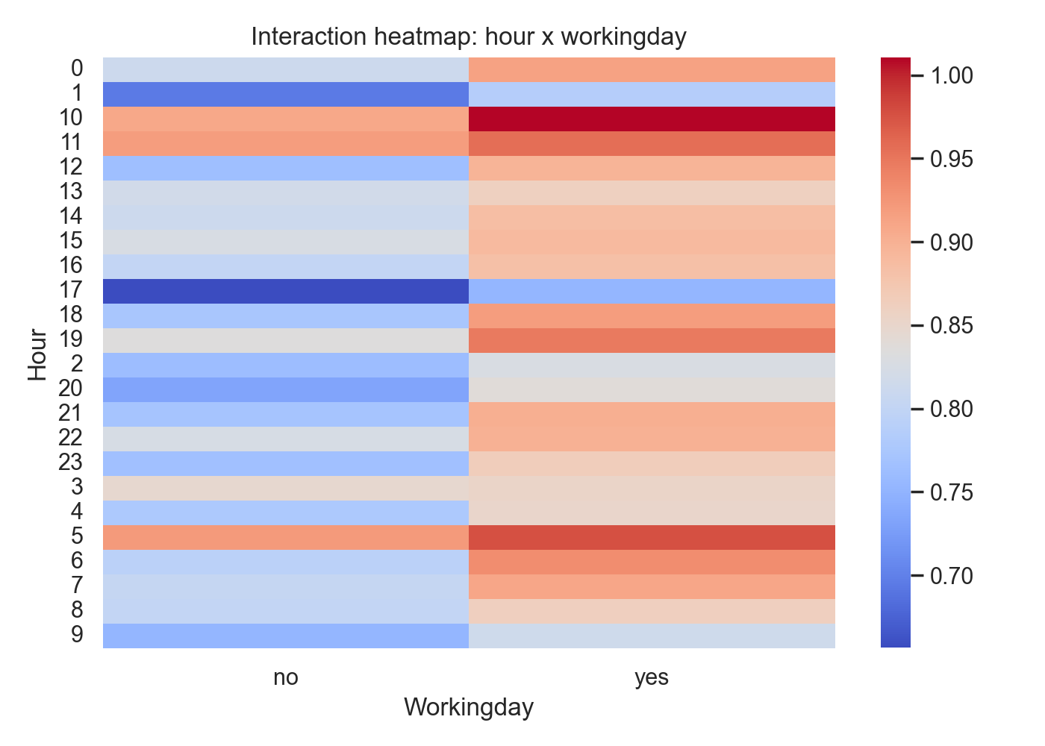
Native Interaction Visualization: Hour vs. Working Day
INTERACTION HEATMAP
Structural Advantage
InstaSHAP's Additive Network Architecture allows for the decomposition of model predictions into local effects and interactions without expensive post-hoc sampling.
Key Observations
Commuter Peaks: Visualization reveals distinct high-usage spikes at 8 AM and 5 PM on working days.
Weekend Variance: Interaction effects shift to mid-day (11 AM - 3 PM) during non-working days.
Latency: Because effects are "read out" from weights, plotting is instantaneous (~0.008s).
Granularity: Captures non-linear nuances that global feature importance scores often miss.

Slide 11



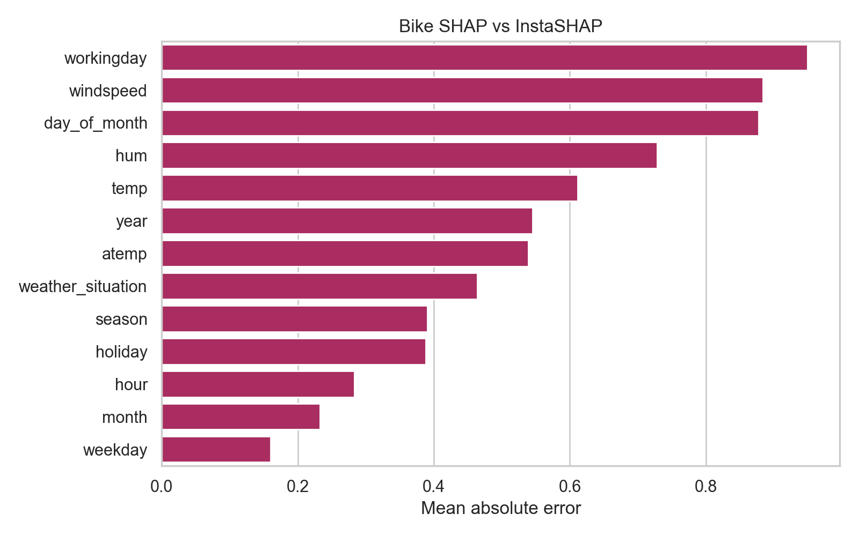


Explanation Fidelity: Performance & Accuracy
Computational Speed
Feature Alignment (Bike Sharing)
Permutation SHAP
12.69s
InstaSHAP
0.008s
~1500x FASTER
InstaSHAP provides near-instantaneous computation compared to traditional methods.
Approximation Error
SHAP vs InstaSHAP MAE
0.5427

Slide 12
Conclusion & Summary
check_circle
insights
speed
Objectives Met
Native Attribution
Production Ready
Successfully reproduced InstaSHAP results across diverse datasets:
• Bike Sharing
• Covertype
• Adult Income
Trained additive models read out SHAP-like attributions natively from model weights.
Eliminates the need for expensive post-hoc sampling.
Unlocks Explainable AI for high-stakes, low-latency production pipelines.
Achieves near-instantaneous explanation (~0.008s).

